Slide 1
Hopfield Networks is all you need
Tamir Shoresh, Dan Goren, Liora Cohen

Slide 2

Agenda
Introduction
Simple Hopfield Network
Modern Hopfield Network
Continuous Valued pattern in Hopfield Network
Hopfield Networks as a General Case of the Attention Mechanism
Hopfield Layer for Deep Learning Architectures
Our Project

Slide 3
Introduction
First introduced in a paper by John Hopfield in 1982
The main purpose of the network is to model a context addressable (Associative) memory

Slide 4
Associative Memory
The main purpose of associative memory networks is to associate an input with its most similar pattern
In other words – store patterns in the network and retrieve them.
We need the network to be attracted to a number of stable states/patterns, and we need a way to control what those states are.

Slide 5
Simple Hopfield Networks

Slide 6
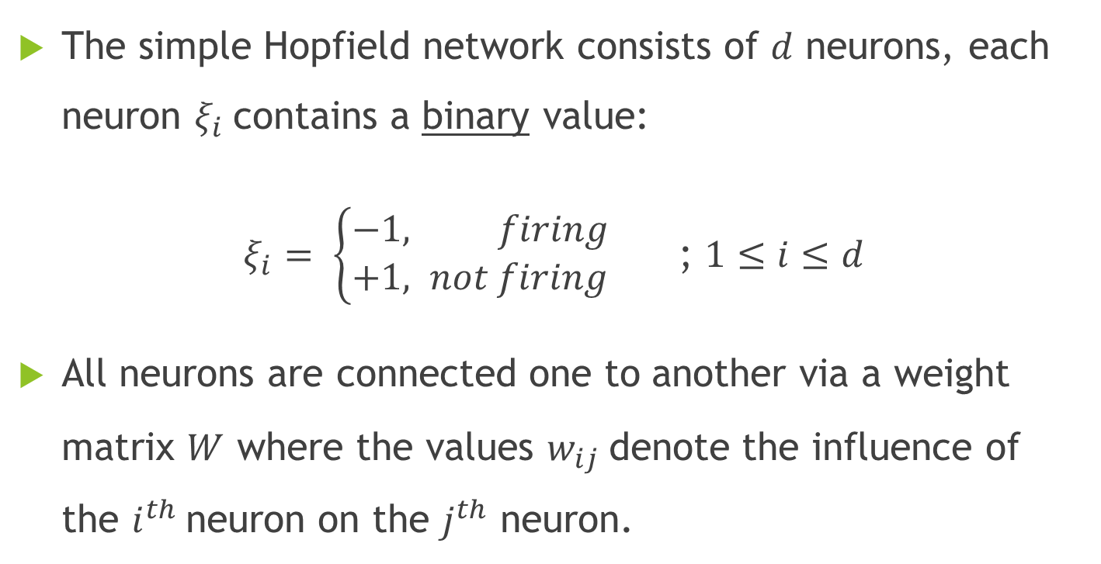
Basic Components of a Simple Hopfield Network
The simple Hopfield network consists of $d$ neurons, each neuron $ξ_{i}$contains a binary value:
$ξ_{i}= \left\{\begin{aligned}−&1, firing \\ +1, not firing\end{aligned}\right.$ ; $1≤i≤d$
All neurons are connected one to another via a weight matrix $W$ where the values $w_{ij}$denote the influence of the $i^{th}$neuron on the $j^{th}$ neuron.

Slide 7
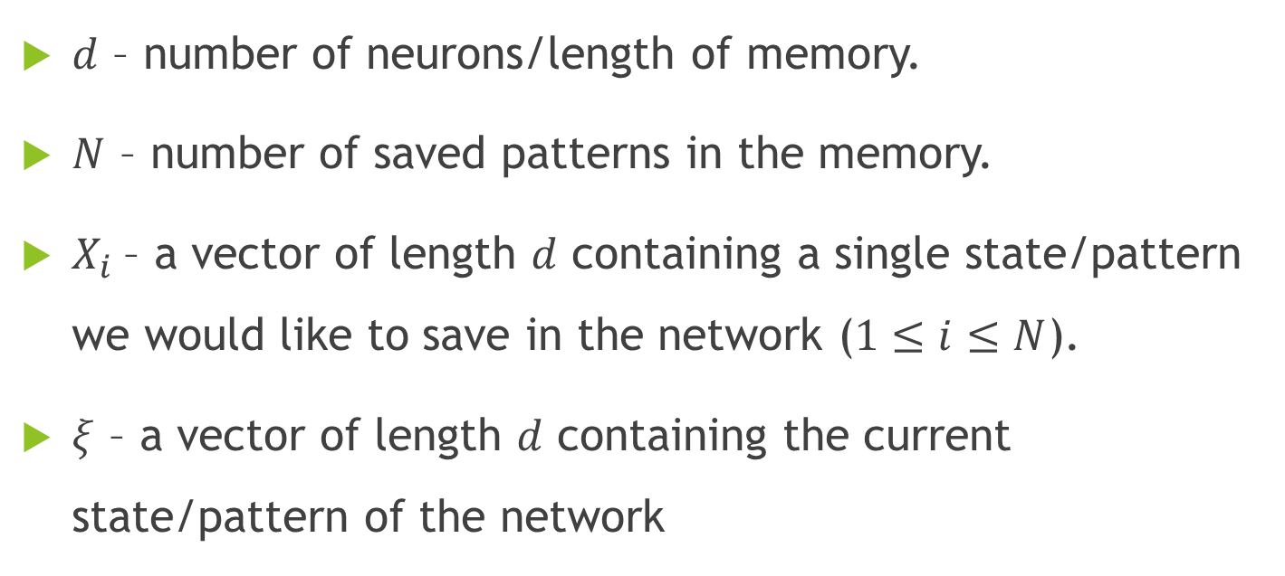
Notations
$d$ – number of neurons/length of memory.
$N$ – number of saved patterns in the memory.
$X_{i}$– a vector of length $d$ containing a single state/pattern we would like to save in the network ($1≤i≤N$).
$ξ$ – a vector of length $d$ containing the current state/pattern of the network

Slide 8
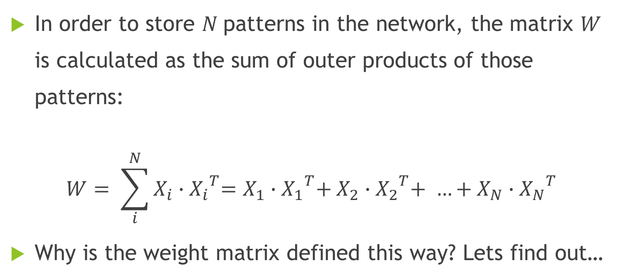

Storing the States $X_{i}$
In order to store $N$patterns in the network, the matrix $W$ is calculated as the sum of outer products of those patterns:
$$W= \sum_{i}^{N}{X_{i}{{∙X}_{i}}^{T}=X_{1}{{∙X}_{1}}^{T}+X_{2}{{∙X}_{2}}^{T}+ …+X_{N}{{∙X}_{N}}^{T}}$$
Why is the weight matrix defined this way? Lets find out…

Slide 9
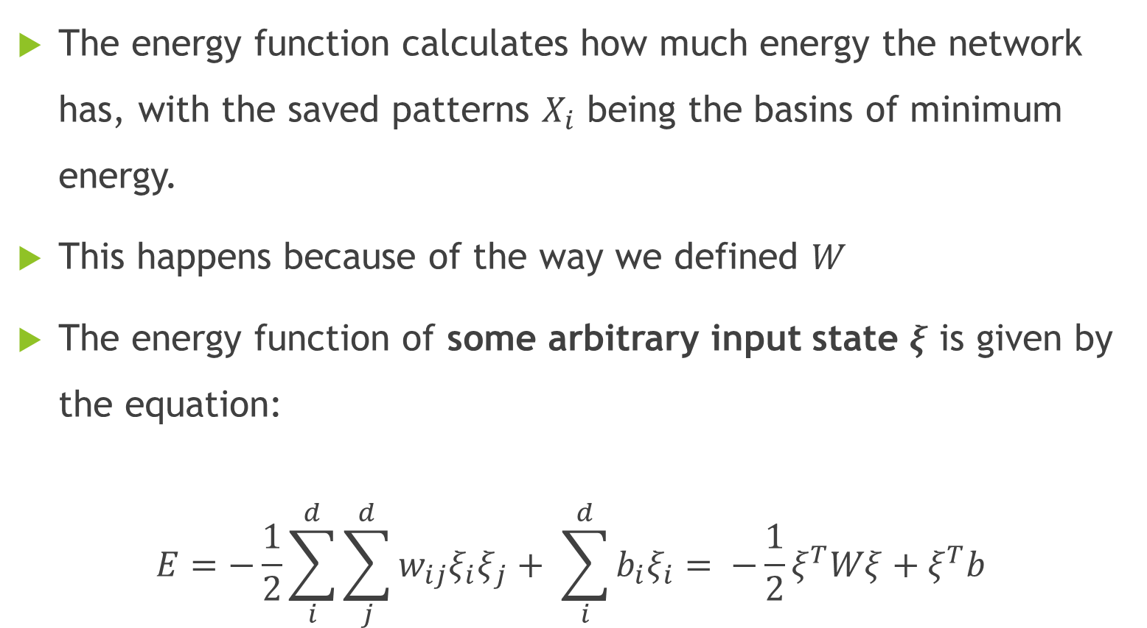
Energy Function
The energy function calculates how much energy the network has, with the saved patterns $X_{i}$ being the basins of minimum energy.
This happens because of the way we defined $W$
The energy function of some arbitrary input state $ξ$ is given by the equation:
$$E=−\frac{1}{2}\sum_{i}^{d}{\sum_{j}^{d}{w_{ij}ξ_{i}ξ_{j}}}+ \sum_{i}^{d}{b_{i}ξ_{i}}= −\frac{1}{2}ξ^{T}Wξ+ξ^{T}b$$

Slide 10
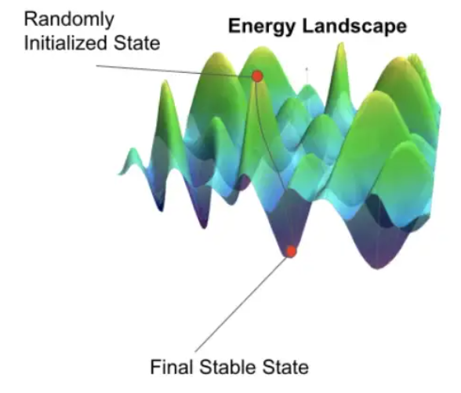
Visualization of Energy Function
We can visualize the Energy function like an egg carton
The minima points represent the saved states
The saddle points might represent the metastable states

Slide 11
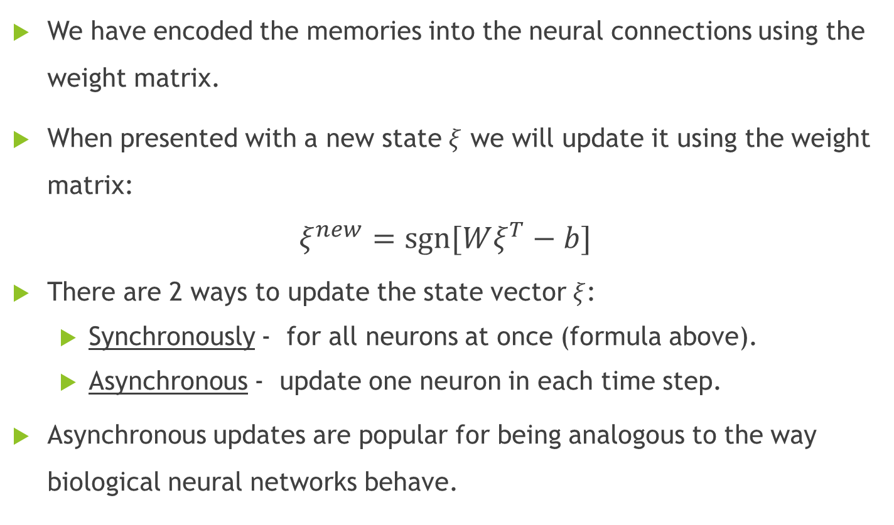
Update Rule (for Minimizing Energy)
We have encoded the memories into the neural connections using the weight matrix.
When presented with a new state $ξ$ we will update it using the weight matrix:
$$ξ^{new}=sgn⁡[Wξ^{T}−b]$$
There are 2 ways to update the state vector $ξ$:
Synchronously - for all neurons at once (formula above).
Asynchronous - update one neuron in each time step.
Asynchronous updates are popular for being analogous to the way biological neural networks behave.

Slide 12
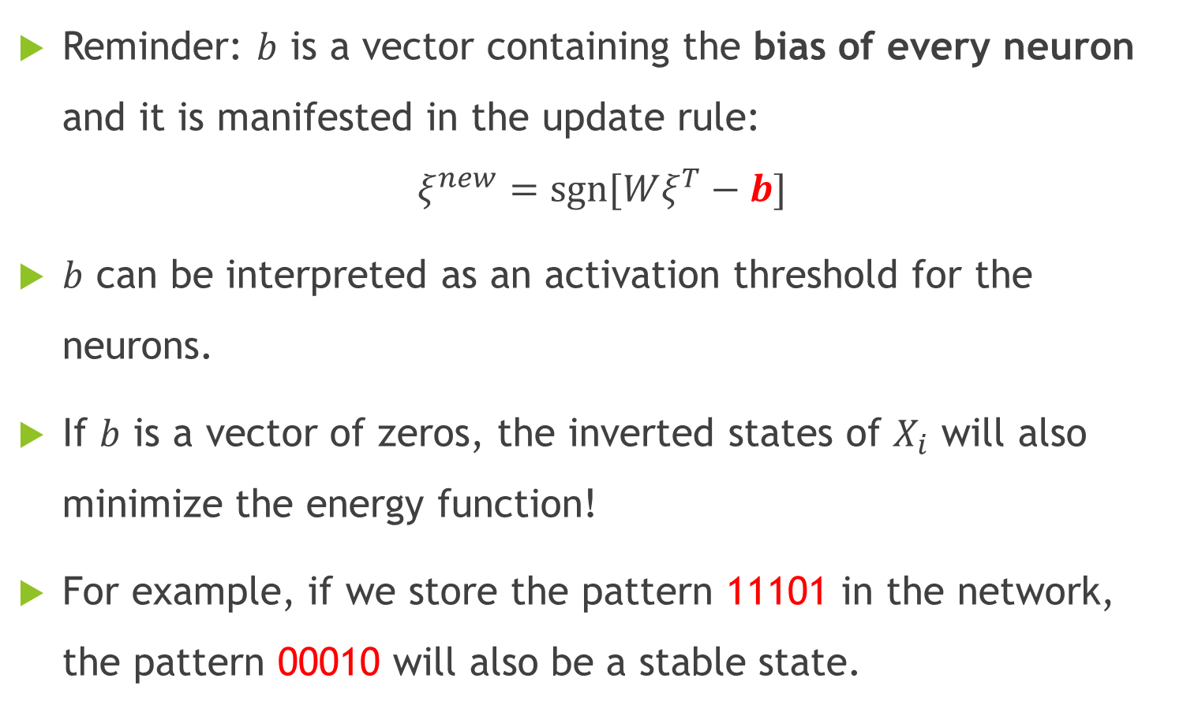
Inverted States
Reminder: $b$ is a vector containing the bias of every neuron and it is manifested in the update rule:
$$ξ^{new}=sgn⁡[Wξ^{T}−b]$$
$b$ can be interpreted as an activation threshold for the neurons.
If $b$ is a vector of zeros, the inverted states of $X_{i}$ will also minimize the energy function!
For example, if we store the pattern 11101 in the network, the pattern 00010 will also be a stable state.

Slide 13
Example 1 Saving One Image to a Simple Hopfield Network

Slide 14
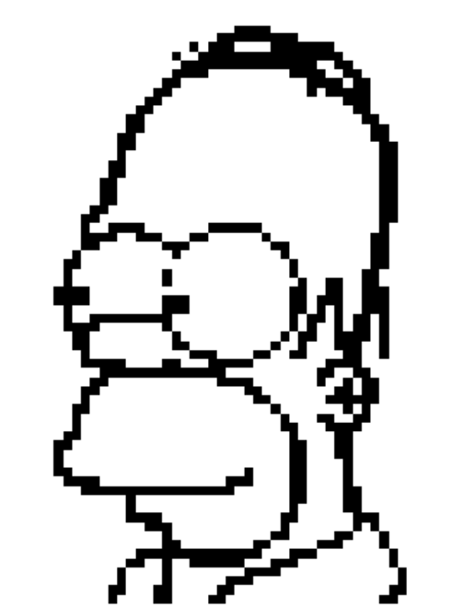



Input - 64x64 RGB image, meaning:
$N=1$
$d=64×64=4096$
Translate the image to B&W for Hopfield representation
Calculate the weight matrix: $W= X_{Homer}X_{Homer}^{T}$
Original Image
B&W Image ($X_{Homer}$)

Slide 15




We enter a query $ξ$ and, using the update rule, we retrieve the stored pattern marked as $ξ^{new}.$
Reminder – the update rule is:
$$ξ^{new}=sgn⁡[Wξ^{T}−b]$$
Basically, we are asking the network “do you have any pattern that looks like $ξ$?”
Query ($ξ$)
Recovered Vector ($ξ^{new}$)

Slide 16
Example 2 Saving Multiple Images to a Simple Hopfield Network

Slide 17
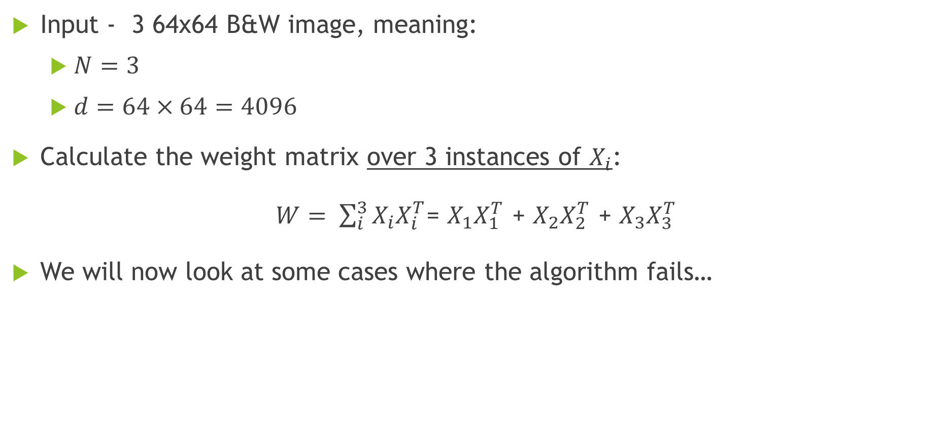
Input - 3 64x64 B&W image, meaning:
$N=3$
$d=64×64=4096$
Calculate the weight matrix over 3 instances of $X_{i}$:
$W= \sum_{i}^{3}{X_{i}X_{i}^{T}}$= $X_{1}X_{1}^{T}$ + $X_{2}X_{2}^{T}$ + $X_{3}X_{3}^{T}$
We will now look at some cases where the algorithm fails…

Slide 18
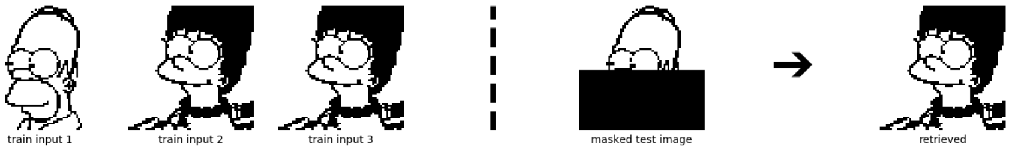

Failure 1 - Overwrite
The weights of $2X_{Marge}$ overwrites the weights of $X_{Homer}$

Slide 19
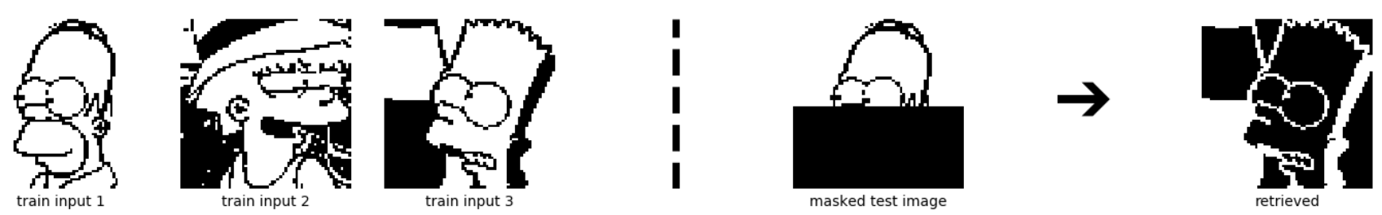
Failure 2 – Inverted States
When we masked the original B&W image of Homer, we turned the values of the bottom half pixels to (-1).
Due to the (-1) values, the “closest” image was the inverse of the Bart image.

Slide 20
Hamming Distance
We can calculate the distance between 2 patterns by using the Hamming distance
“the Hamming distance between two strings of equal length is the number of positions at which the symbols are different”
String 1 = ‘1 1 1 0 1’
String 2 = ‘1 1 0 0 1’
Now we can explain the Hopfield Network as converging to the pattern with the shortest Hamming distance from the current state!
Hamming dist. = 1

Slide 21
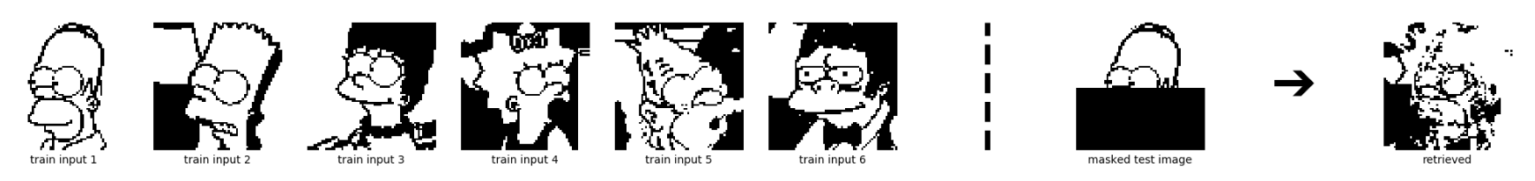
Failure 3 – Metastable states
When two or more patterns have a short Hamming distance from one another the algorithm may converge to a local minimum close, but not identical, to the stored pattern.
When two or more patterns have a very short Hamming distance from one another the algorithm may converge to a local minimum at a metastable state.

Slide 22
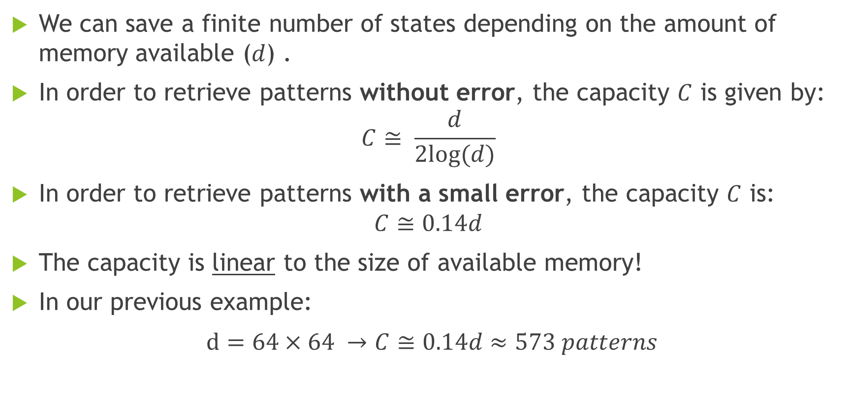
Memory Capacity
We can save a finite number of states depending on the amount of memory available ($d$) .
In order to retrieve patterns without error, the capacity $C$ is given by:
$$C≅ \frac{d}{2log⁡(d)}$$
In order to retrieve patterns with a small error, the capacity $C$ is:
$$C≅0.14d$$
The capacity is linear to the size of available memory!
In our previous example:
$d=64×64 →C≅0.14d≈573 patterns$

Slide 23
Modern Hopfield Networks

Slide 24
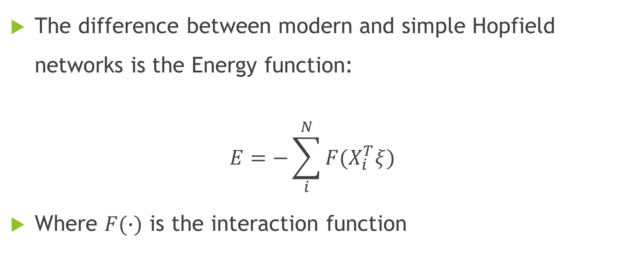
Energy Function of Modern Hopfield Network
The difference between modern and simple Hopfield networks is the Energy function:
$$E=−\sum_{i}^{N}{F(X_{i}^{T}ξ)}$$
Where $F(∙)$ is the interaction function

Slide 25
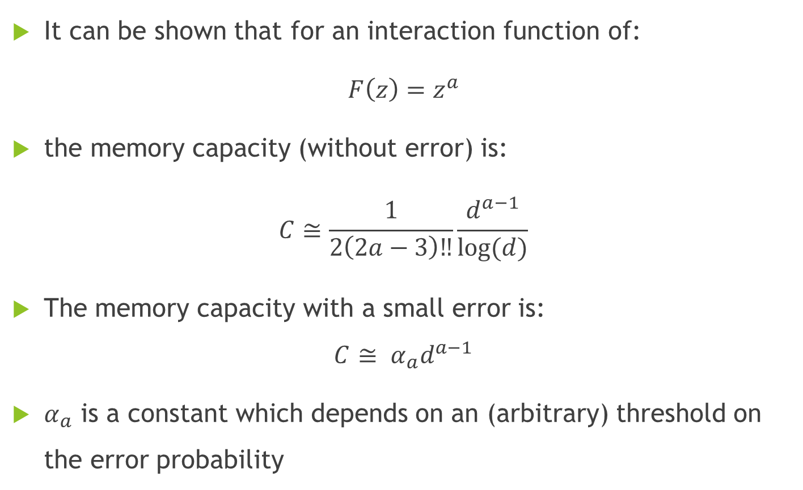
Polynomial Interaction Function
It can be shown that for an interaction function of:
$F\left(z\right)=z^{a}$
the memory capacity (without error) is:
$$C≅\frac{1}{2\left(2a−3\right)‼}\frac{d^{a−1}}{log⁡(d)}$$
The memory capacity with a small error is:
$$C≅ α_{a}d^{a−1}$$
$α_{a}$ is a constant which depends on an (arbitrary) threshold on the error probability

Slide 26
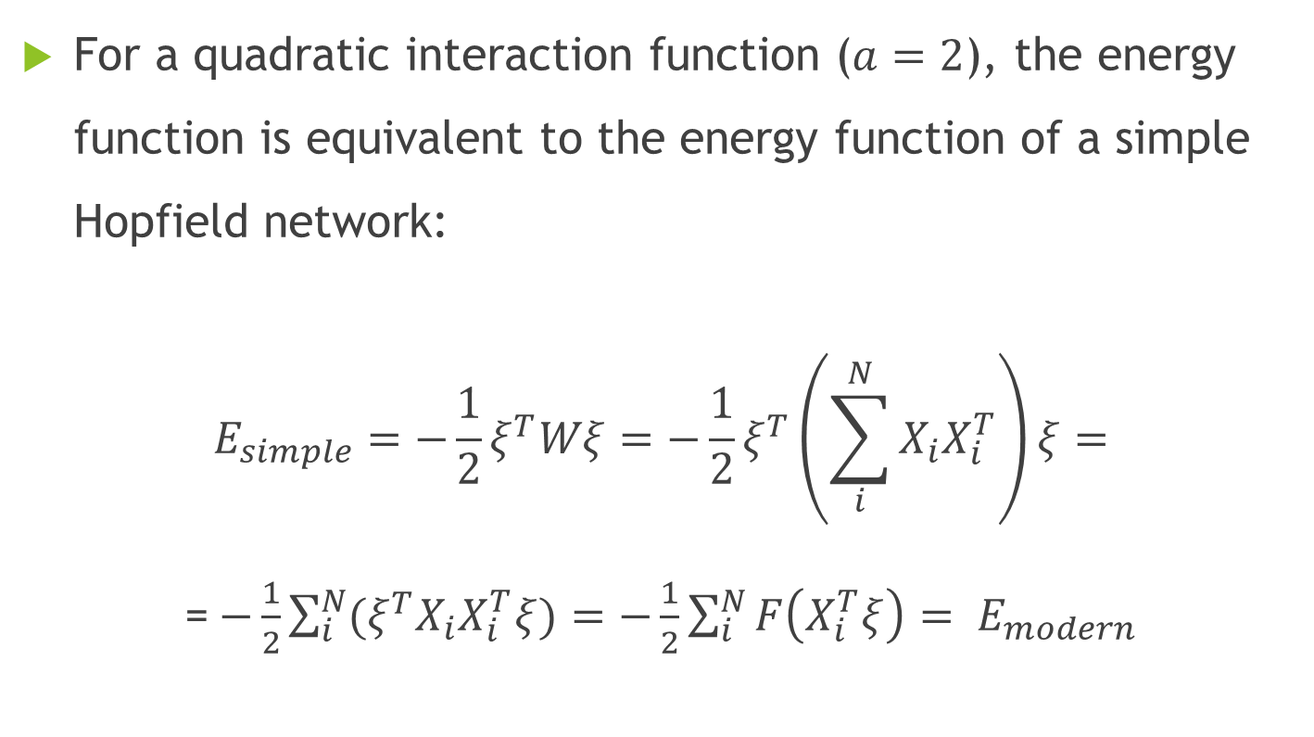

Special Case - $F\left(z\right)= z^{2}$
For a quadratic interaction function ($a=2$), the energy function is equivalent to the energy function of a simple Hopfield network:
$$E_{simple}=−\frac{1}{2}ξ^{T}Wξ=−\frac{1}{2}ξ^{T}\left(\sum_{i}^{N}{X_{i}X_{i}^{T}}\right)ξ=$$
=$−\frac{1}{2}\sum_{i}^{N}{{(ξ}^{T}X_{i}X_{i}^{T}ξ})=−\frac{1}{2}\sum_{i}^{N}{F\left(X_{i}^{T}ξ\right)}= E_{modern}$

Slide 27
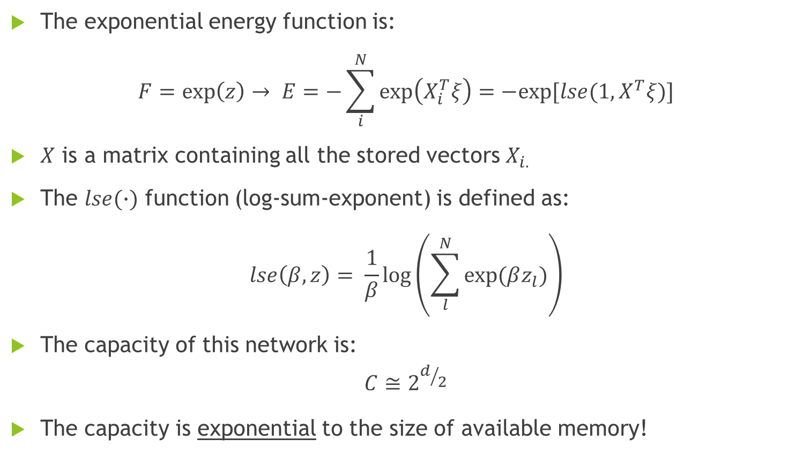
Exponential Interaction Function
The exponential energy function is:
$$F=\exp\left(z\right)→ E=−\sum_{i}^{N}{\exp\left(X_{i}^{T}ξ\right)=−exp⁡[lse(1, X^{T}ξ)]}$$
$X$ is a matrix containing all the stored vectors $X_{i.}$
The $lse(∙)$ function (log-sum-exponent) is defined as:
$$lse\left(β, z\right)= \frac{1}{β}log\left(\sum_{l}^{N}{exp⁡(βz_{l})}\right)$$
The capacity of this network is:
$$C≅2^{d/2}$$
The capacity is exponential to the size of available memory!

Slide 28
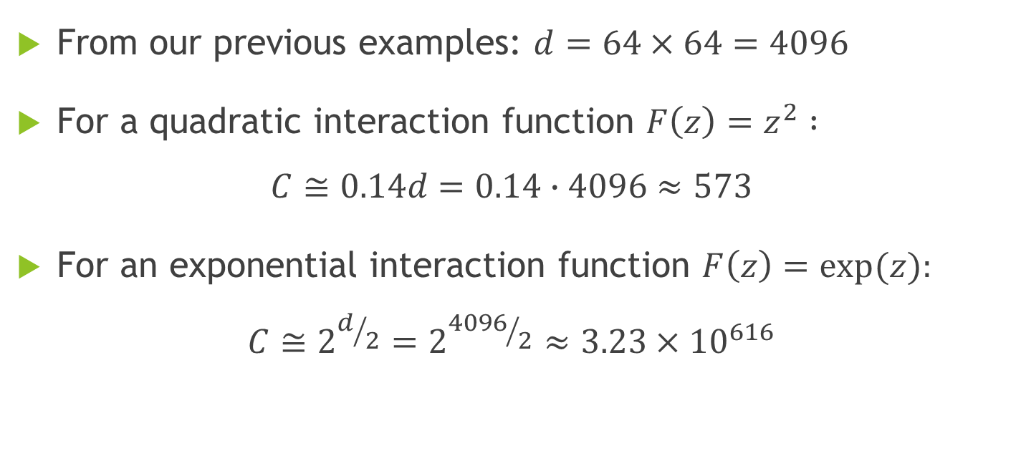
Example – Capacity Calculation
From our previous examples: $d=64×64=4096$
For a quadratic interaction function $F\left(z\right)=z^{2} :$
$$C≅0.14d=0.14∙4096≈573$$
For an exponential interaction function $F\left(z\right)=exp⁡(z):$
$$C≅2^{d/2}=2^{{4096}/2}≈3.23×{10}^{616}$$

Slide 29
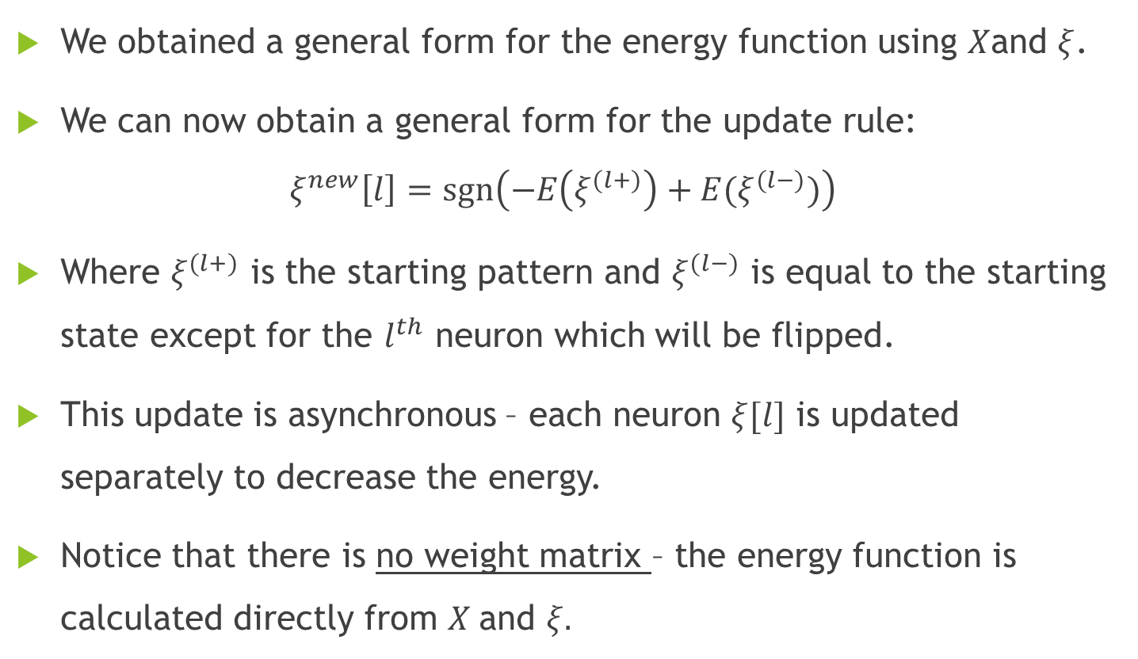
General Update Rule
We obtained a general form for the energy function using $X$and $ξ$.
We can now obtain a general form for the update rule:
$$ξ^{new}\left[l\right]=sgn\left(−E\left(ξ^{(l+)}\right)+E(ξ^{(l−)})\right)$$
Where $ξ^{(l+)}$ is the starting pattern and $ξ^{(l−)}$ is equal to the starting state except for the $l^{th}$ neuron which will be flipped.
This update is asynchronous – each neuron $ξ[l]$ is updated separately to decrease the energy.
Notice that there is no weight matrix – the energy function is calculated directly from $X$and $ξ.$

Slide 30
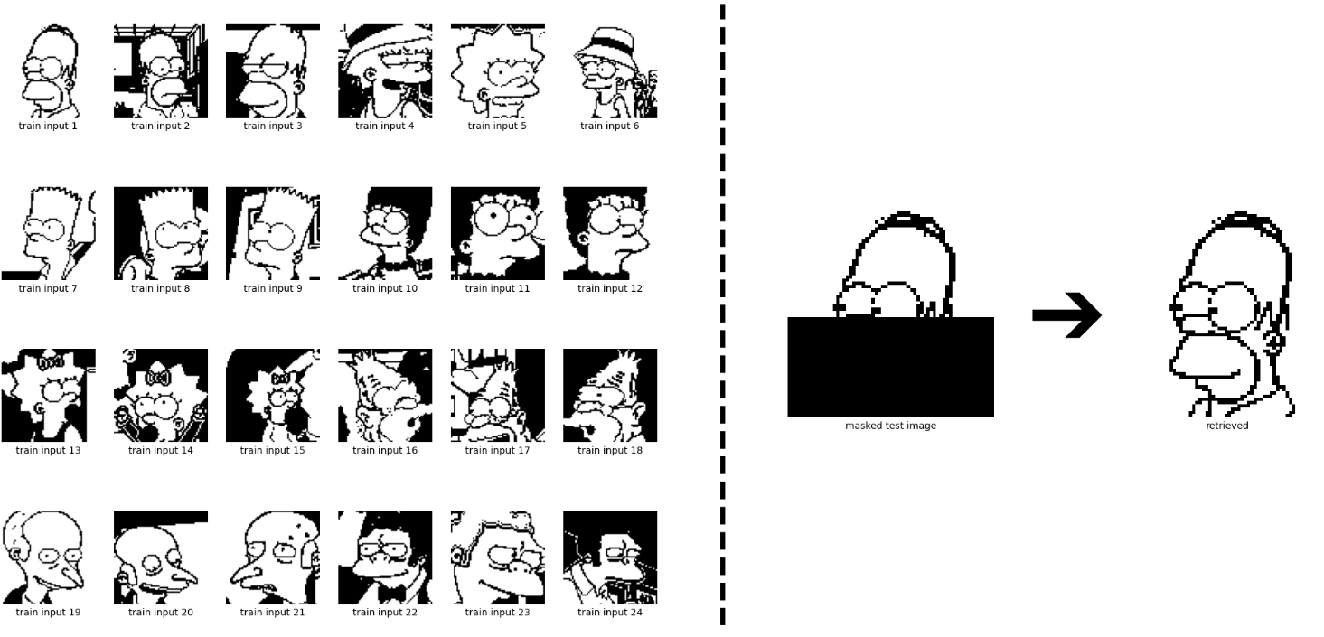
Example with Capacity Enlargement

Slide 31
Continuous-valued Patterns in Hopfield Networks

Slide 32
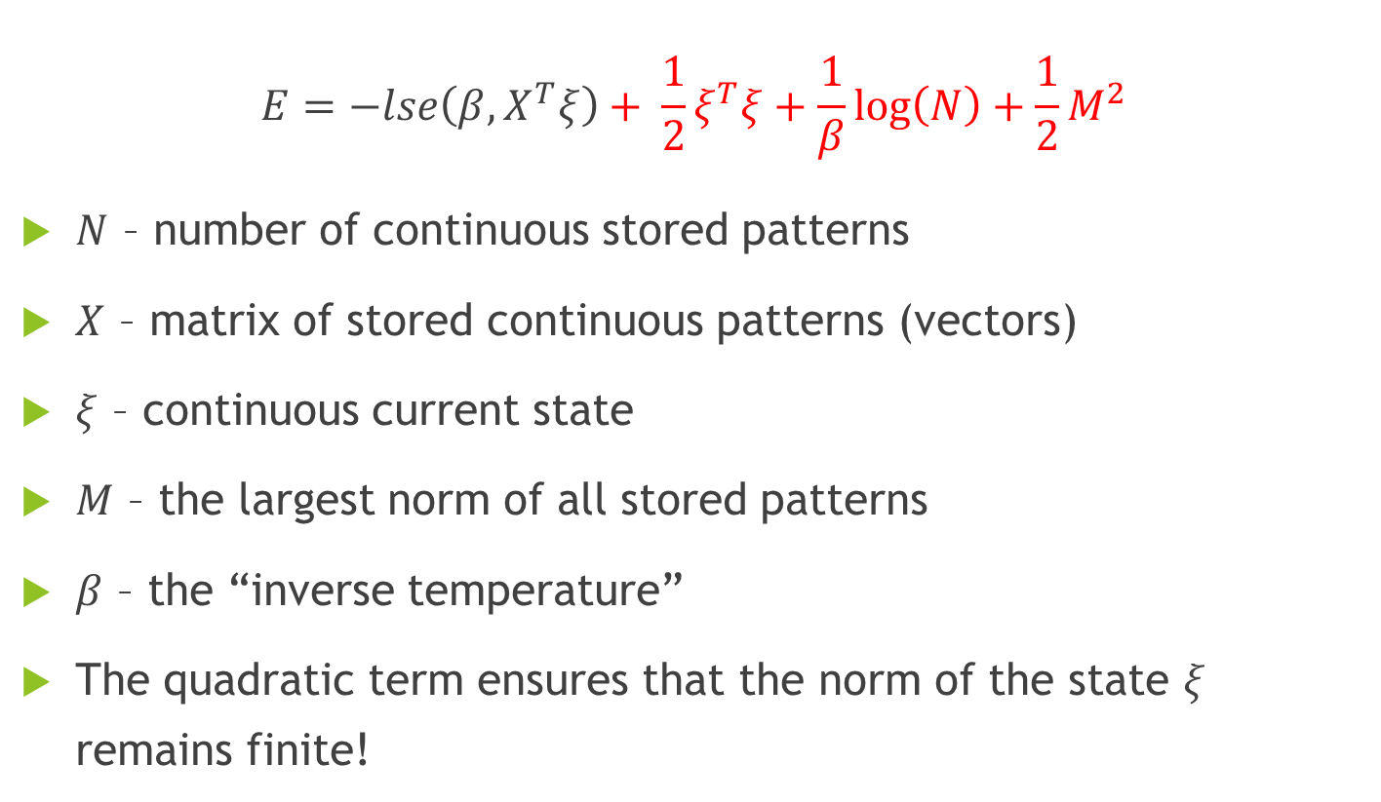
Energy Function for Continuous Values
$$E=−lse\left(β, X^{T}ξ\right)+ \frac{1}{2}ξ^{T}ξ+\frac{1}{β}\log\left(N\right)+\frac{1}{2}M^{2}$$
$N$ – number of continuous stored patterns
$X$ – matrix of stored continuous patterns (vectors)
$ξ$ – continuous current state
$M$ – the largest norm of all stored patterns
$β$ – the “inverse temperature”
The quadratic term ensures that the norm of the state $ξ$ remains finite!

Slide 33
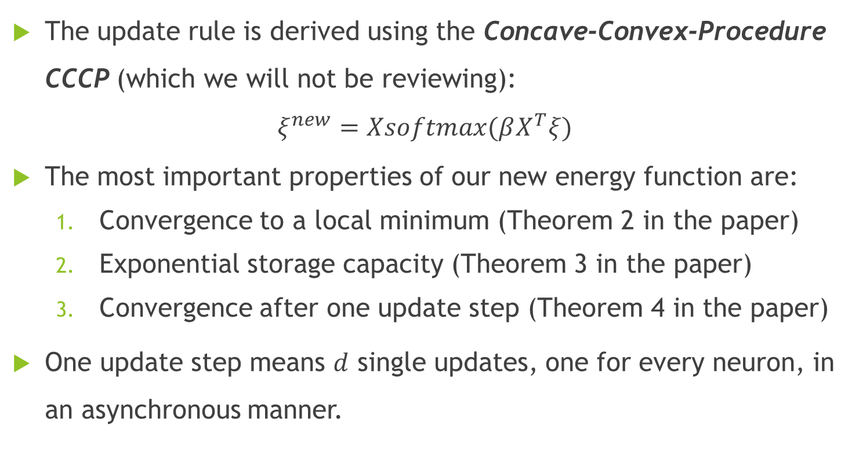
Deriving the Update Rule
The update rule is derived using the Concave-Convex-Procedure CCCP (which we will not be reviewing):
$$ξ^{new}=Xsoftmax(βX^{T}ξ)$$
The most important properties of our new energy function are:
Convergence to a local minimum (Theorem 2 in the paper)
Exponential storage capacity (Theorem 3 in the paper)
Convergence after one update step (Theorem 4 in the paper)
One update step means $d$ single updates, one for every neuron, in an asynchronous manner.

Slide 34
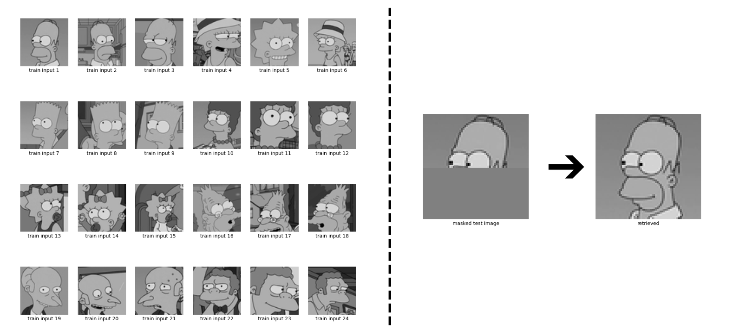
Example with Continuous Patterns

Slide 35
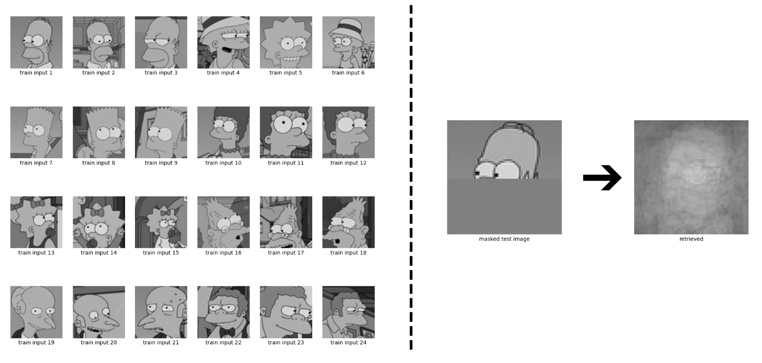
Metastable States in Continuous Patterns

Slide 36

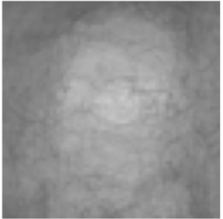



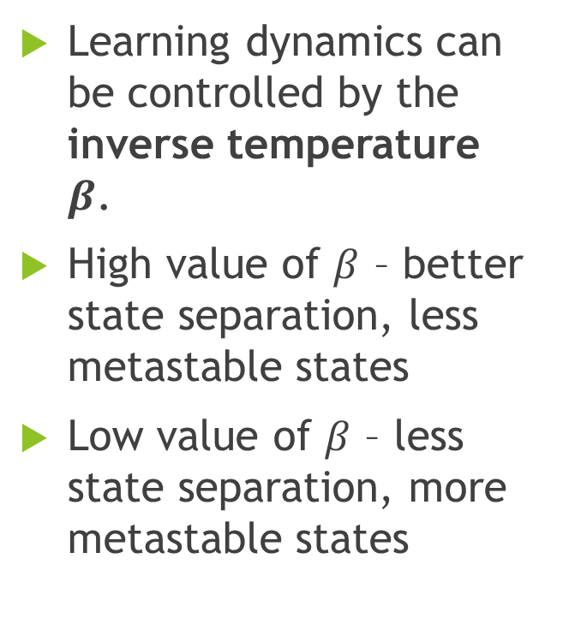


Metastable States in Continuous Patterns
Learning dynamics can be controlled by the inverse temperature $β$.
High value of $β$ – better state separation, less metastable states
Low value of $β$ – less state separation, more metastable states
Masked
$$β=0.25$$
$$β=2$$
$$β=8$$

Slide 37
Hopfield Networks as a General Case of the Attention Mechanism

Slide 38
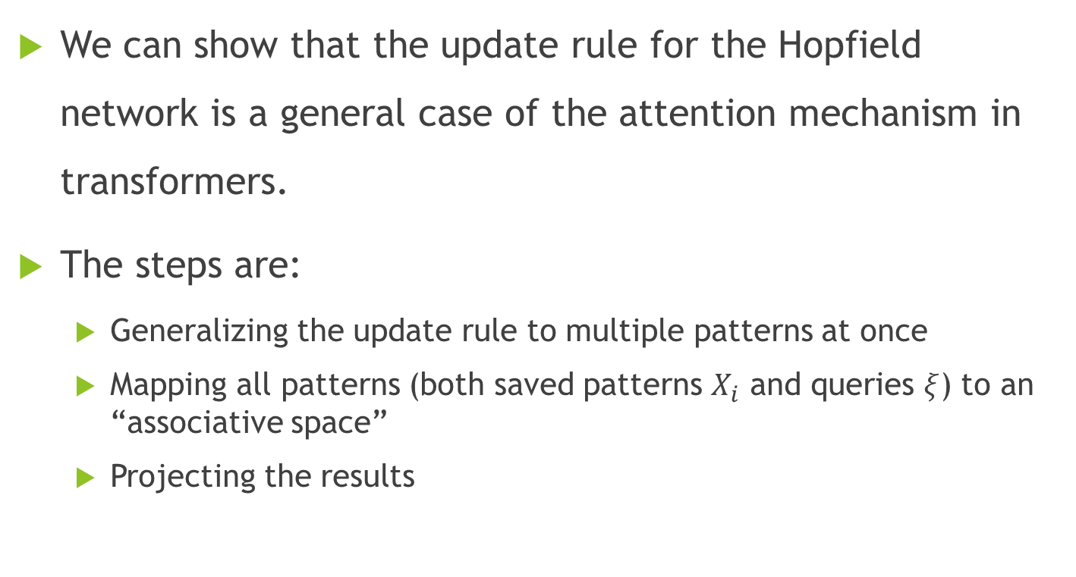
Analogy between Hopfield and Attention
We can show that the update rule for the Hopfield network is a general case of the attention mechanism in transformers.
The steps are:
Generalizing the update rule to multiple patterns at once
Mapping all patterns (both saved patterns $X_{i}$ and queries $ξ$) to an “associative space”
Projecting the results

Slide 39
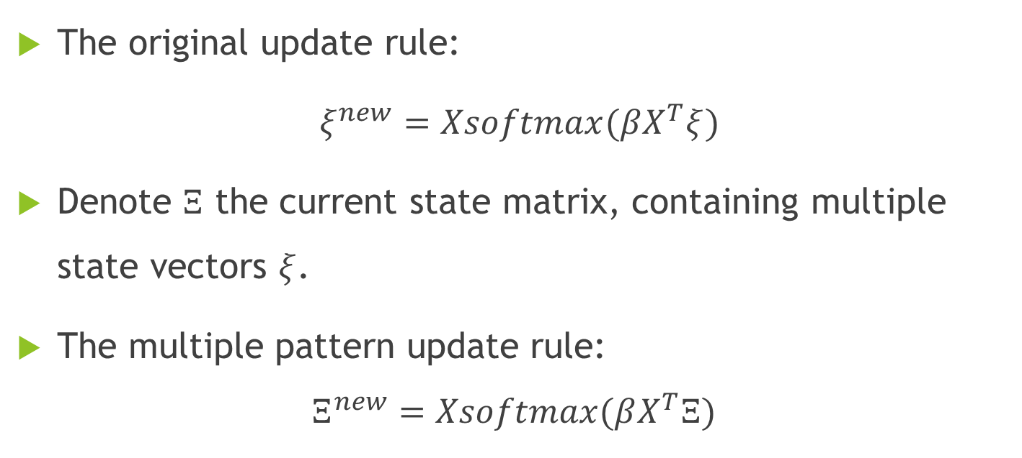
Generalizing the Update Rule for Multiple Patterns
The original update rule:
$ξ^{new}=Xsoftmax(βX^{T}ξ)$
Denote $Ξ$ the current state matrix, containing multiple state vectors $ξ$.
The multiple pattern update rule:
$$Ξ^{new}=Xsoftmax(βX^{T}Ξ)$$

Slide 40
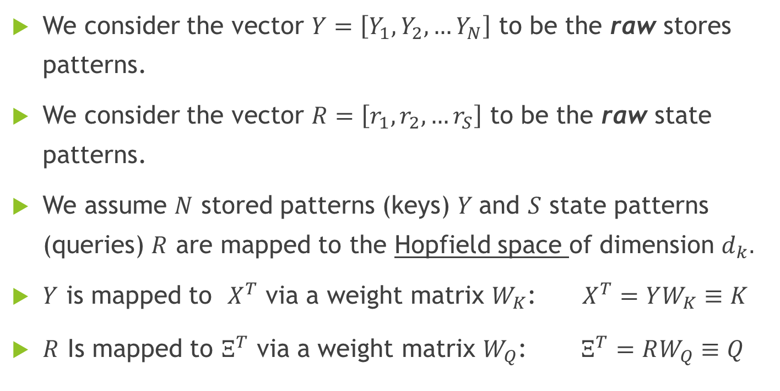
Mapping Patterns to an Associative Space
We consider the vector $Y=\left[Y_{1},Y_{2},…Y_{N}\right]$ to be the raw stores patterns.
We consider the vector $R=\left[r_{1},r_{2},…r_{S}\right]$ to be the raw state patterns.
We assume $N$ stored patterns (keys) $Y$and $S$ state patterns (queries) $R$ are mapped to the Hopfield space of dimension $d_{k}.$
$Y$ is mapped to $X^{T}$ via a weight matrix $W_{K}$: $X^{T}=YW_{K}≡K$
$R$ Is mapped to $Ξ^{T}$ via a weight matrix $W_{Q}$: $Ξ^{T}=RW_{Q}≡Q$

Slide 41
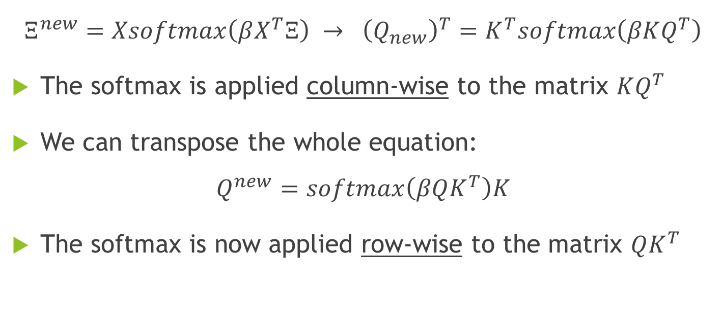
Re-writing the Update Rule
$$Ξ^{new}=Xsoftmax\left(βX^{T}Ξ\right) → {\left(Q_{new}\right)}^{T}=K^{T}softmax\left(βKQ^{T}\right)$$
The softmax is applied column-wise to the matrix $KQ^{T}$
We can transpose the whole equation:
$$Q^{new}=softmax\left(βQK^{T}\right)K$$
The softmax is now applied row-wise to the matrix $QK^{T}$

Slide 42
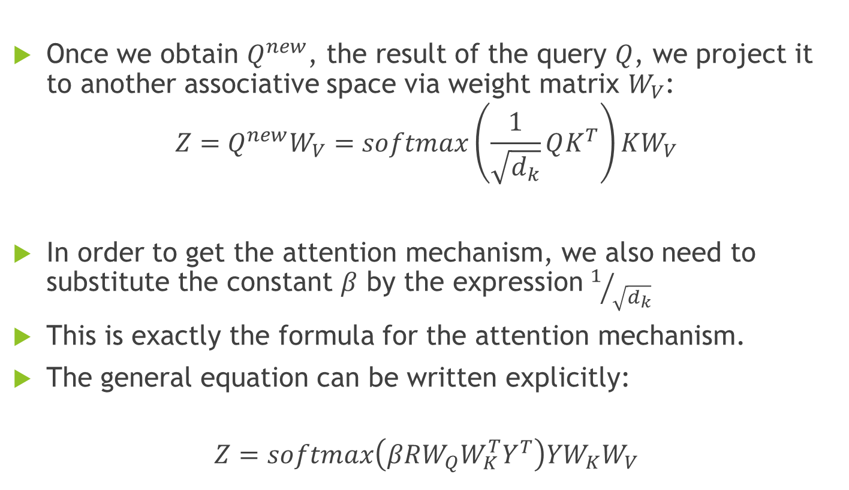
Projecting the Results
Once we obtain $Q^{new}$, the result of the query $Q$, we project it to another associative space via weight matrix $W_{V}$:
$$Z=Q^{new}W_{V}=softmax\left(\frac{1}{\sqrt{d_{k}}}QK^{T}\right)KW_{V}$$
In order to get the attention mechanism, we also need to substitute the constant $β$ by the expression $1/{\sqrt{d_{k}}}$
This is exactly the formula for the attention mechanism.
The general equation can be written explicitly:
$$Z=softmax\left(βRW_{Q}{W_{K}^{T}Y}^{T}\right)YW_{K}W_{V}$$

Slide 43
Why is this important?
There are many applications to the general form of the Hopfield network
Hopfield network layers have been shown for replacing many different layer types such as:
Pooling layers
GRU (Cho et al., 2014)
LSTM (Hochreiter, 1991; Hochreiter & Schmidhuber, 1997)
Attention layers (Vaswani et al., 2017a;b; Bahdanau et al., 2014)

Slide 44
Hopfield Layer for Deep Learning Architectures

Slide 45
The Different Hopfield Layers
The insights on modern Hopfield Networks allows us to introduce new PyTorch Hopfield layers for DNNs.
These layers can be used as plug-in replacement for existing layers as well as for specific applications as shown before.
The layers are:
Hopfield
HopfieldPooling
HopfieldLayer

Slide 46
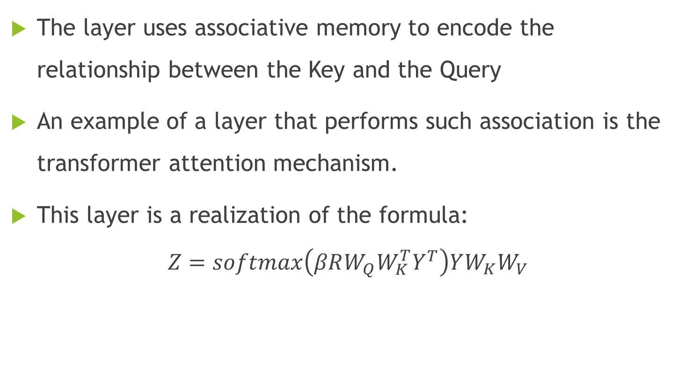
Layer Hopfield
The layer uses associative memory to encode the relationship between the Key and the Query
An example of a layer that performs such association is the transformer attention mechanism.
This layer is a realization of the formula:
$$Z=softmax\left(βRW_{Q}{W_{K}^{T}Y}^{T}\right)YW_{K}W_{V}$$

Slide 47
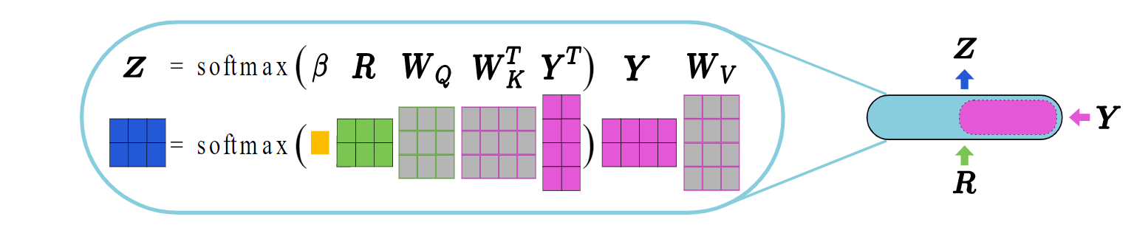

Layer Hopfield
The expression $W_{K}W_{V}$ is marked as $\tilde{W_{V}}$, and in order to generalize even more, is treated as a stand-alone matrix, and is independent of $W_{K}$ and ${ W}_{V}$.
The only constraint on $\tilde{W_{V}}$ is the size – same size as $W_{K}W_{V}.$
From now on we denote $\tilde{W_{V}}$ as just $W_{V}$.

Slide 48
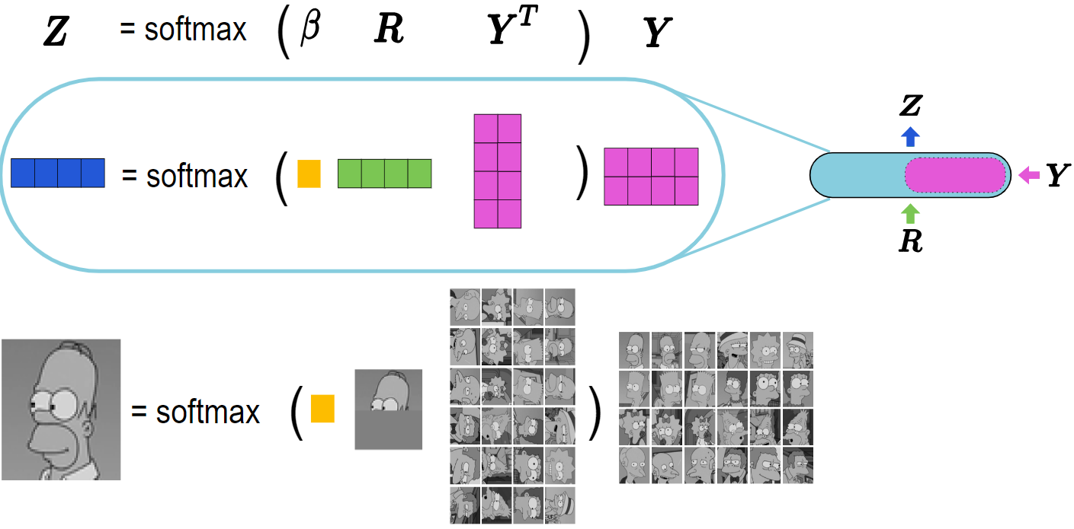
Layer HopfieldLayer
$$Ξ^{new}=Xsoftmax(βX^{T}Ξ)$$
This layer includes fixed memories
Simplest example -using a single layer to solve the image retrieval problem:

Slide 49
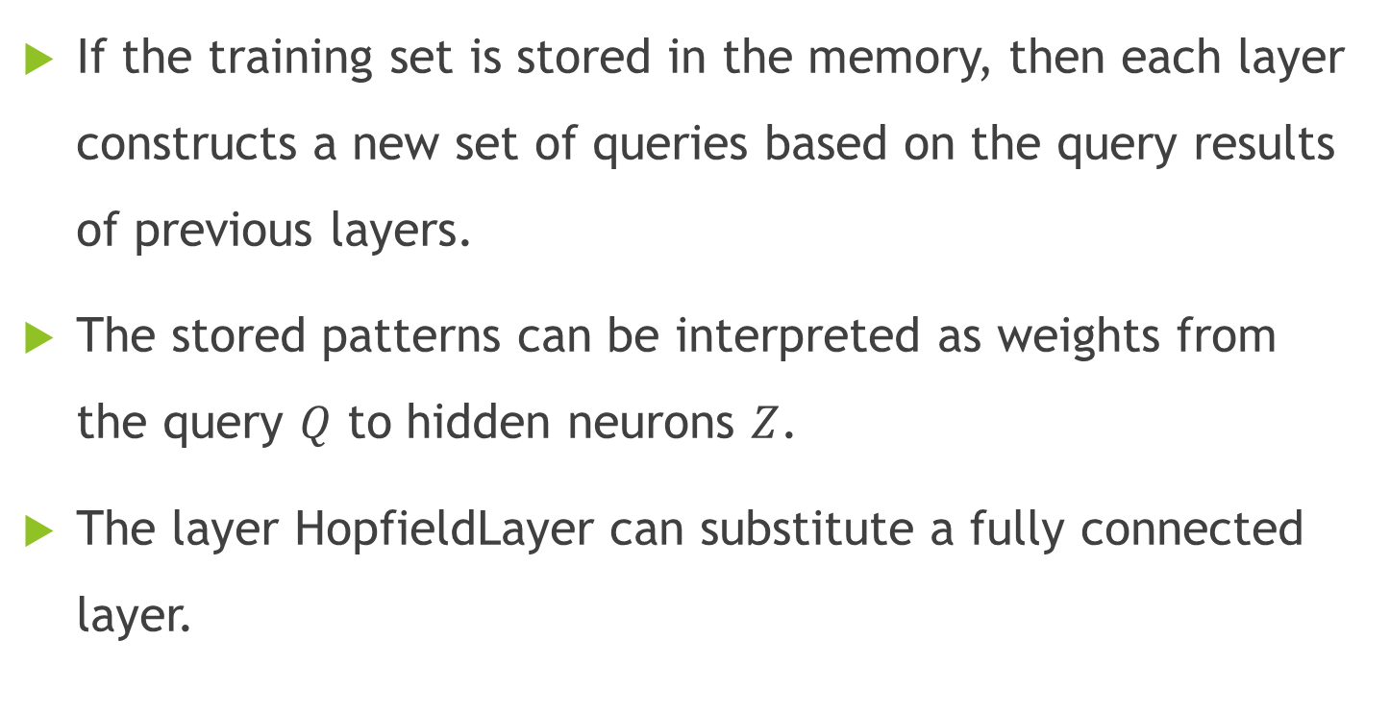
Layer HopfieldLayer
If the training set is stored in the memory, then each layer constructs a new set of queries based on the query results of previous layers.
The stored patterns can be interpreted as weights from the query $Q$ to hidden neurons $Z$.
The layer HopfieldLayer can substitute a fully connected layer.

Slide 50
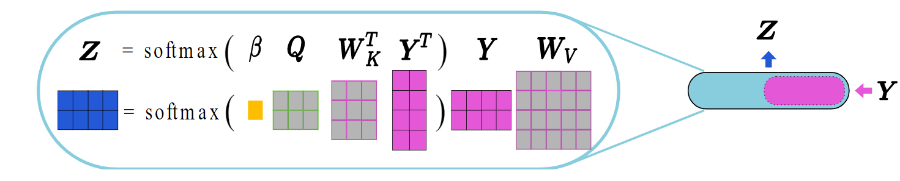
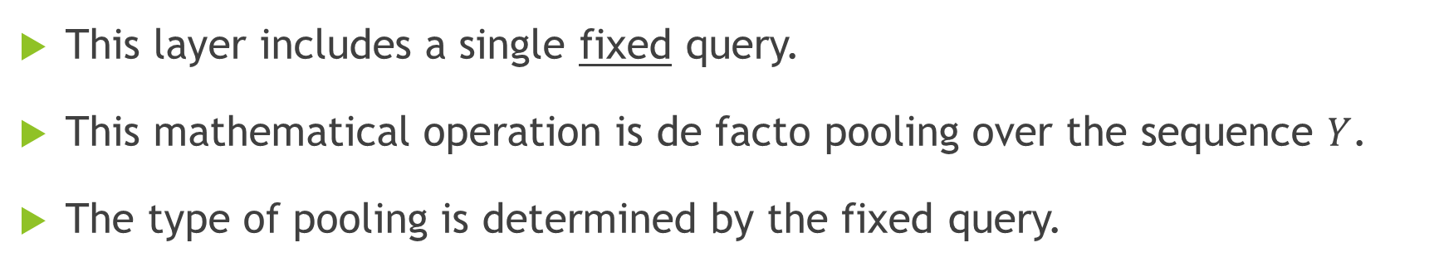
Layer HopfieldPooling
This layer includes a single fixed query.
This mathematical operation is de facto pooling over the sequence $Y$.
The type of pooling is determined by the fixed query.

Slide 51
Our Project
Motivation
Dataset
Methodology

Slide 52
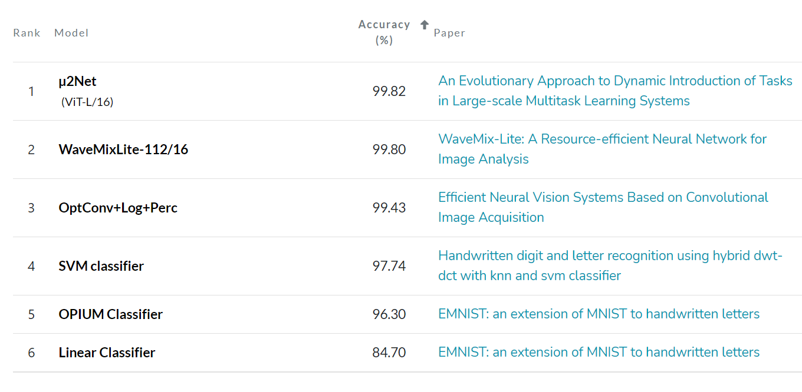
Motivation
Creating a model by using Hopfield Layers to classify EMNIST letters.
Benchmarks:

Slide 53
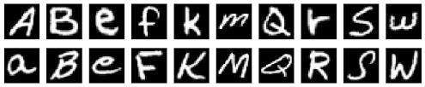
Dataset
The EMNIST dataset is a set of handwritten letters
EMNIST Letters: 145,600 characters. 26 balanced classes (5,600 per class)
Grayscale. 28X28 pixels

Slide 54
Methodology
Image Augmentation
Horizontal shifting/ vertical shifting
Rotation
Feed extended DB to network
Flattened layer (28X28 = 784)
Model Optimization
Architecture parameters
Hyperparameters
K Hopfield heads
1 Dense Layer
Dense output layer of size 26
Zoom in/ Zoom out

Slide 55
Model Optimization
Architecture Parameters | Hyperparameters
Number of parallel Hopfield heads Size of Dense Layers Optimizer | Inverse temperature (beta) Dropouts (%) Learning rates Epochs Batch size

Slide 56
Timelines
 | Task | Deadline
1 | Literature Review of Hopfield Network | Nov 20, 2022
2 | Presentation 1 | Nov 27, 2022
3 | Pytorch Tutorial | Dec 05, 2022
4 | Data retrieval and augmentation | Dec 13, 2022
5 | Create Auxiliaries functions | Dec 20, 2022
6 | Build and Train 1st Model | Dec 23, 2022
7 | Optimizing architecture parameters & Hyperparameters | Jan 01, 2023
8 | Presentation 2 | Jan 10, 2023
9 | Final Report | Feb 01, 2023

Slide 57
Thank You!

